Slide 1
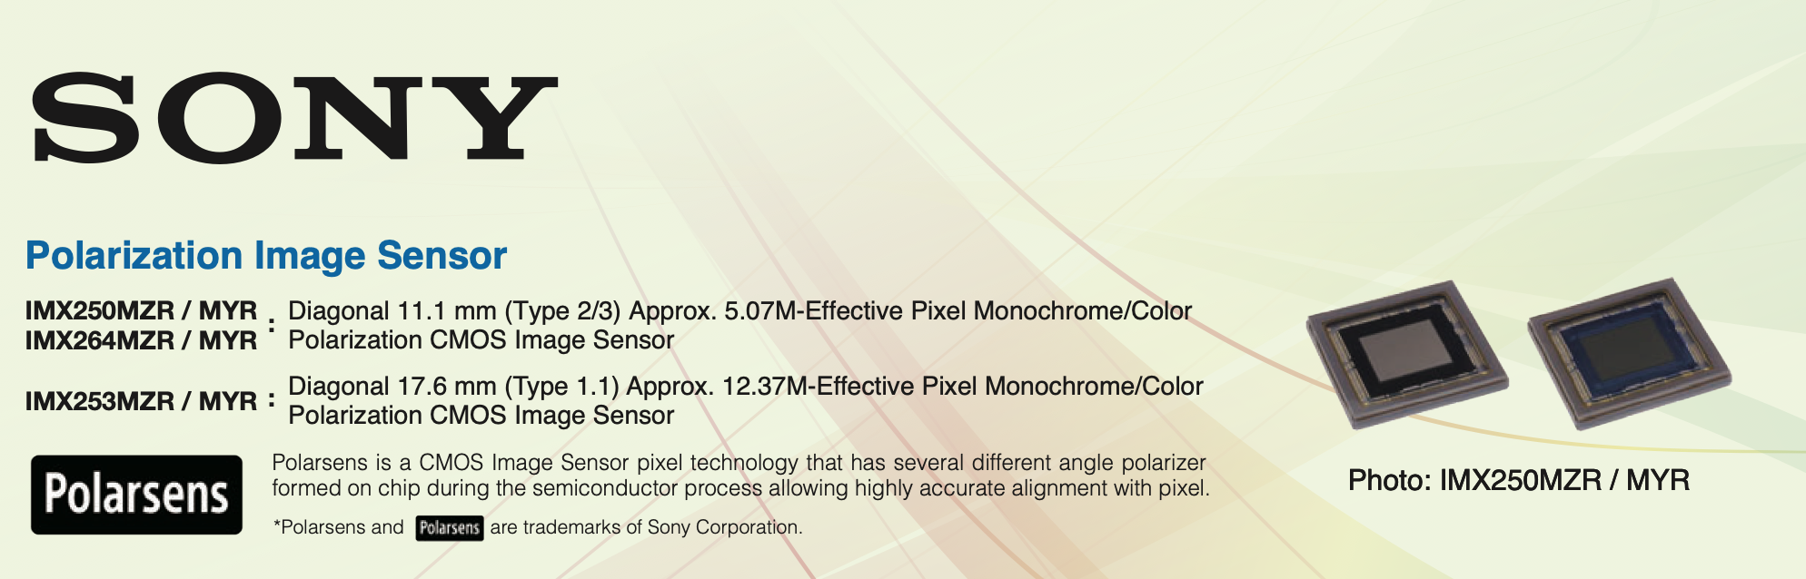
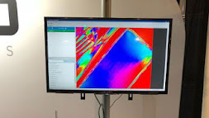
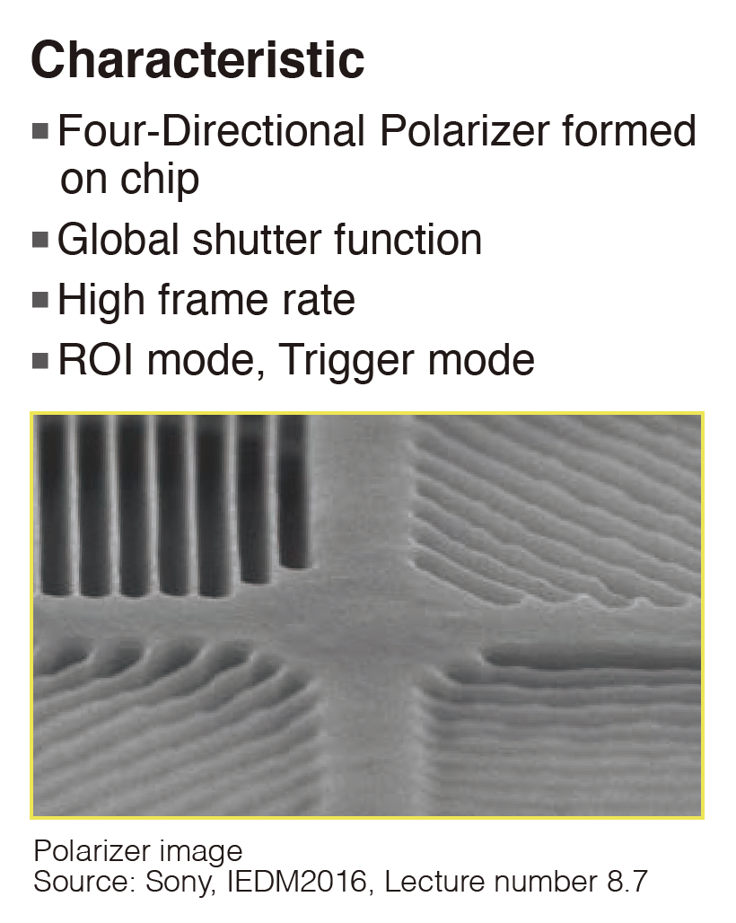
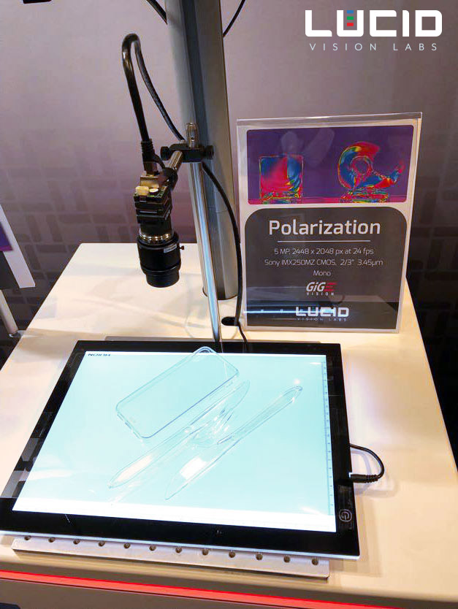
In 2018, Sony released its first CMOS- based polarization imaging sensors, which integrated patterned wire grid polarizers on-chip onto the pixels.
Nowadays, the Sony IMX250MZR/MYR, IMX253MZR/MYR and IMX264MZR/MYR sensors are commonly available in various electronics packages from several vendors, with options for monochrome and RGB color, and a range of detector formats and read-out speeds.

Slide 2
Wire grid polarization is the principle behind Sony’s Polarized CMOS sensors
Principle: a wire grid polarizer consists of a fine grid of closely spaced parallel metal wires on a substrate.
Polarization interaction: When light hits the grid, the electric field component that is parallel to the wires excite electrons in the wires, causing them to oscillate and absorb the energy of that polarization. Polarized parallel light is reflected and adsorbed by the wires while perpendicular light passes through.

Slide 3
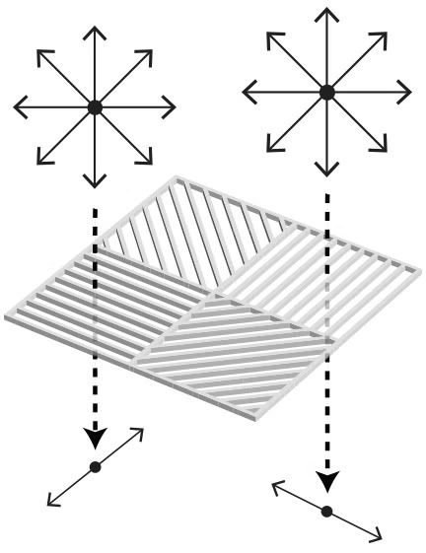
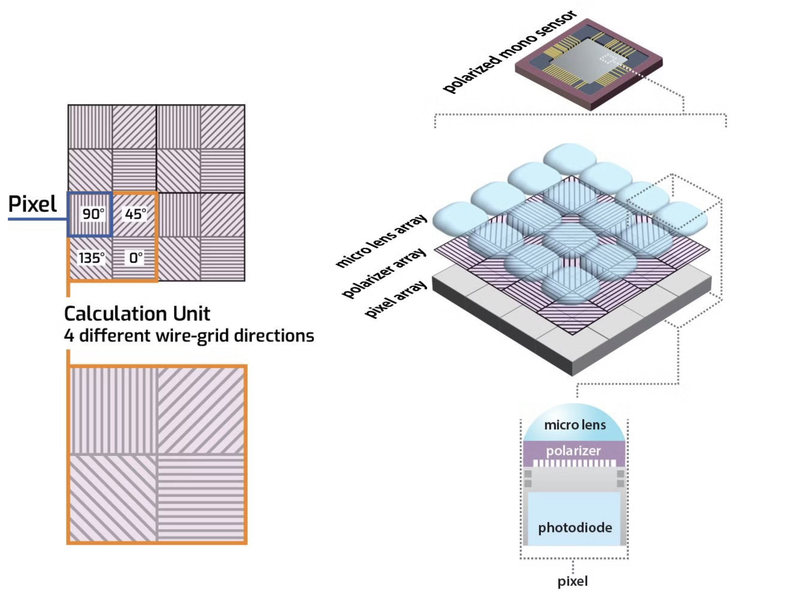
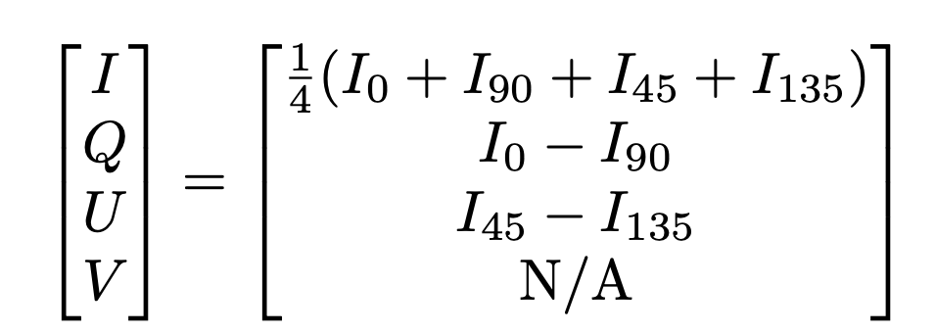
The polarizer array is comprised of four different angled polarizers (90°, 45°, 135° and 0°) which are placed on 3.45 μm pixel. Every block of four pixels makes up a calculation unit.
The relationship between the different directional polarizers in this innovative 4-pixel block design allows the calculation of both the degree and direction of polarization.
Stokes: Q, U, I

Slide 4
Sony’s polarization sensor reduces the chance of crosstalk thanks to the polarizer array being placed on-chip.
In the example below, the 0° polarized light is unable to enter the pixel meant to detect only 90°.

Slide 5

https://arxiv.org/pdf/2405.07864v1
With proper calibration: precision of ~0.001

Slide 6
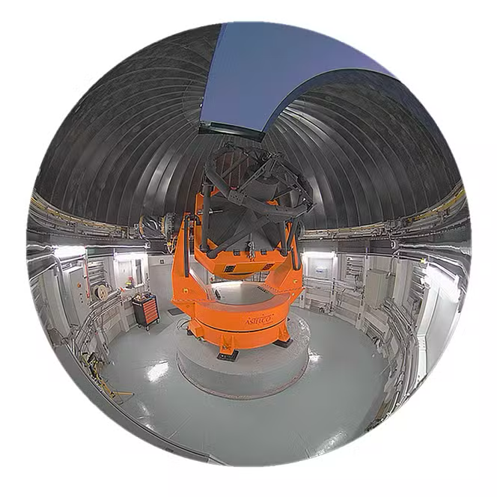

Slide 7

Transient Events Q, U and I, Light Analyzer
for COLIBRÍ
COLIBRÍ has opened-up a new window for early GRB afterglow science. This proposal is for adding the polarimetry capability to COLIBRÍ to monitor in real time the optical linear (Q, U, I) polarization of bright (r ~ 17) GRB afterglows.
We propose to replace the OGSE camera with a polarized camera with a new technology, a sensor developed by Sony which is currently only targeting the industrial equipment, Sony Polarsens™ . This sensor capture the light polarization with a single acquisition over the entire image, pixel by pixel and can calculate real-time information about the direction and degree of polarization.
This technology has never been used on a telescope. This would serve as a test for low-cost polarimetry solutions for astronomy. If successful, it will likely trigger R&D of polarized cameras at other wavelengths. This polarized camera will replace the “test camera” currently on COLIBRÍ.
The system would have no mechanisms or moving parts.
We will be able to switch in ~21 seconds to DDRAGO from TEQUILA if we have a new GRB alert.
Also, thanks to COLIBRÍ ability to move quickly, it will provide a unique window for polarimetry measurements (in less than a minute) for any other bright (r > 17) transients' alerts from the Rubin Observatory Full Stream Alert Broker.

Slide 8

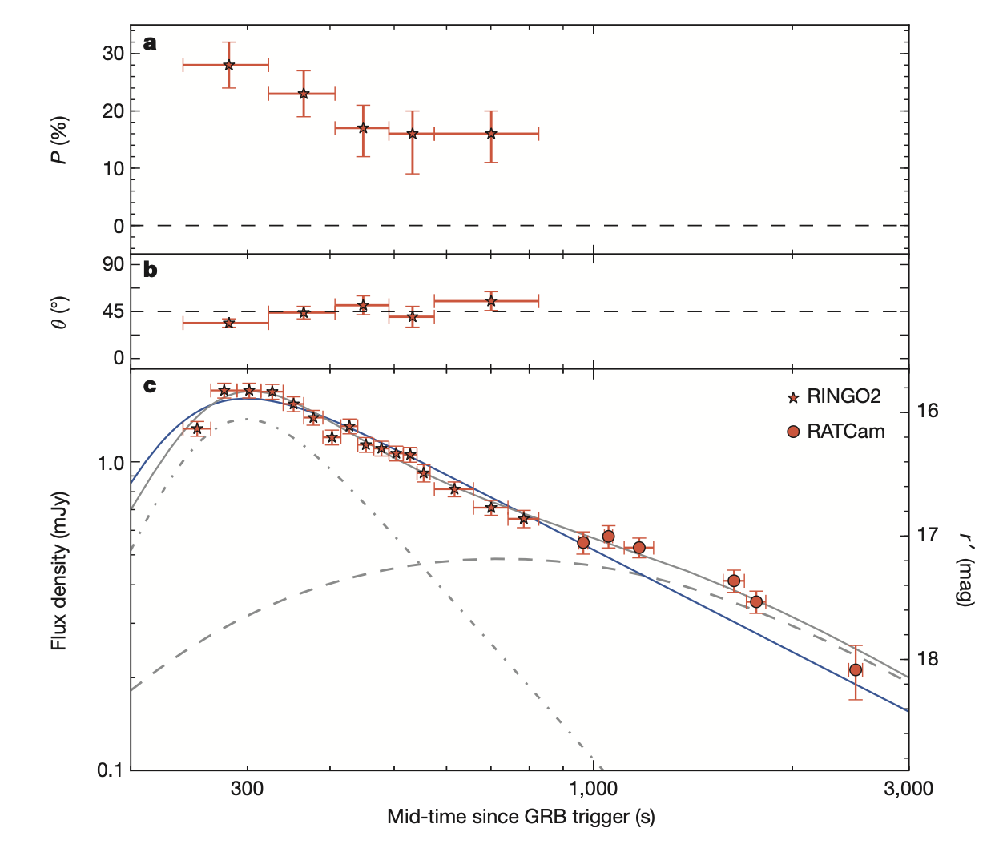
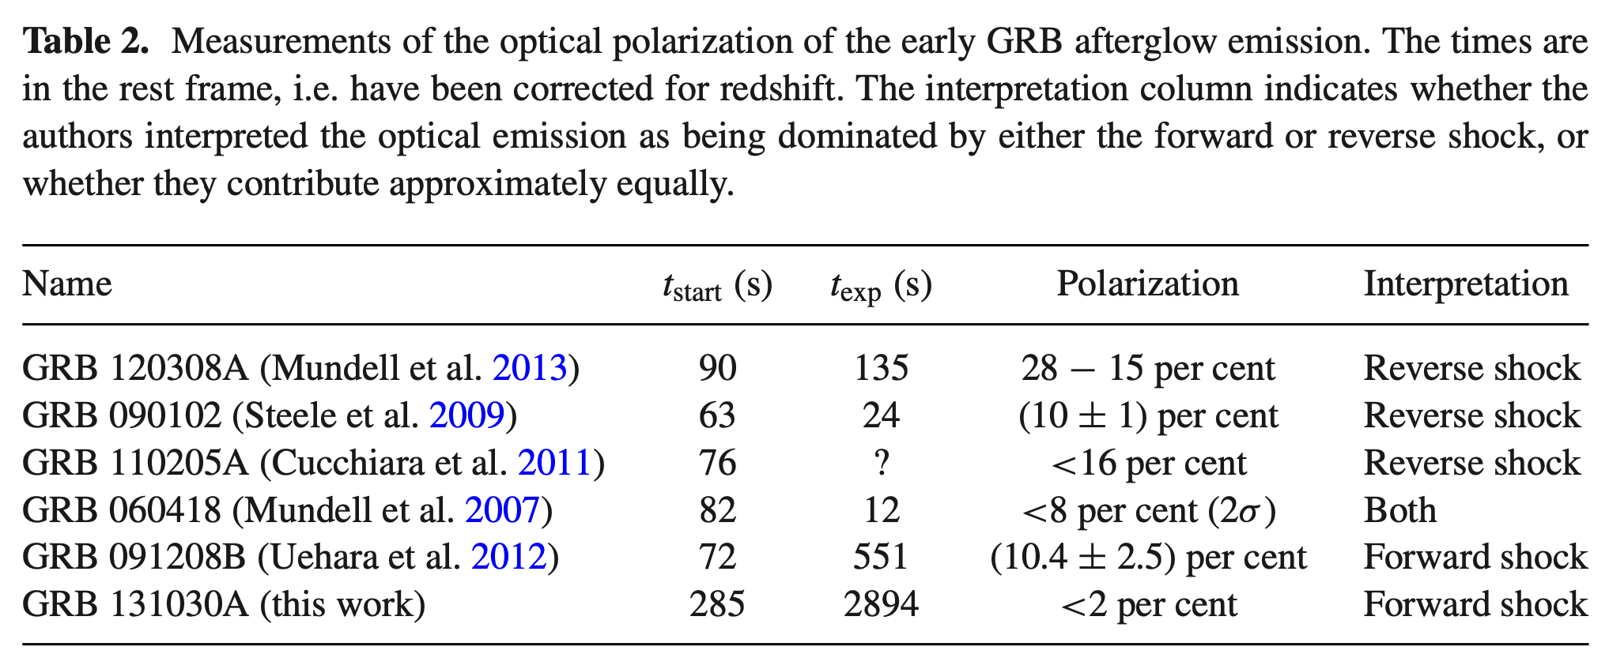

Slide 9
Chronology
March 2025: First discussions with Alan Watson (TEQUILA Feasibility Study), Stéphane Basa and William Lee.
First discussion with companies (specs, quotes) and funding (Noémie Globus).
This project has triggered the interest of a postdoc candidate (Ny Avo Rakotondrainibe) who will include this as a project in his research proposal for UNAM.
Fall 2025: Installation?

Slide 10
"Tequila may not be the answer, but it's worth a shot”

Slide 11
